Slide 1
BOD (Biological Oxygen Demand)
It is a measure of amount of oxygen required for the biological oxidation of organic matter under aerobic conditions at 20⁰ C for a period of 5 days.
Organic matter + O₂ Micro-organisms CO₂ + H₂O
BOD is the direct measurement of extent of pollution in waste water & industrial effluent.
Only applicable for bio-degradable pollutants.
Higher the BOD, higher will be the level of pollutants in water.
Drinking water should have BOD less than 1 ppm.

Slide 2

Principle
Dissolved oxygen content of diluted waste-water is determined at the beginning of the reaction by Winkler’s method or by DO meter.
Same sample of water is kept for incubation in the presence of micro-organisms for 5 days at 20⁰ C and decrease in the dissolved oxygen content is determined by Winkler’s method or by DO meter.
BOD = [(DO)_{Blank} – (DO)_{Incubated} ] X Dilution Factor
(DO)_{Blank} = Dissolved oxygen of diluted sample in the beginning of the reaction
(DO)_{Incubated} = Dissolved oxygen of diluted sample after incubation for 5 days at 20 ⁰ C.

Slide 3
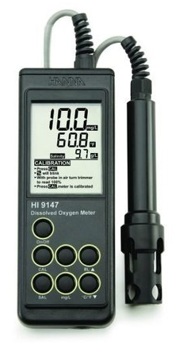
BOD Meter

Slide 4
Significance of BOD
BOD gives the extent of bio-degradable pollutants in wastewater sample
It also helps in pollution control in water
It also express self-purification capacity of any water body.

Slide 5
COD (Chemical Oxygen Demand)
It is a measure of amount of oxygen required for the chemical oxidation of organic matter when refluxed in acidified potassium dichromate in the presence of Ag₂SO₄ or HgSO₄ catalyst for 3 hours.
CxHyOz + (X + Y/4 – Z/2) O₂ X CO₂ + (Y/2) H₂O
(Organic matter) [O]
COD is the direct measurement of extent of pollution in waste water & industrial effluent.
Applicable for both bio-degradable and non bio-degradable pollutants.
Higher the COD, higher will be the level of pollutants in water.
Drinking water should have COD less than 1 ppm.

Slide 6
Principle
A known volume of waste water sample (say 250 ml) is refluxed with a known excess of standard potassium dichromate (1 N) and dilute/conc. sulfuric acid mixture in the presence of silver sulphate catalyst for about 3 hours.
This oxidases organic matter to CO₂, NH₃ and H₂O.
The unreacted potassium dichromate is titrated against Ferrous ammonium sulphate (Mohr’s salt) with ferroin indicator till blue colour changes to wine red, the reading is (Vt).
This gives the amount of potassium dichromate consumed (in terms of equivalent oxygen) required for degradation of organic pollutants.
Blank titration is performed initially with known volume of waste water sample and added acidified standard potassium dichromate titrated against Ferrous ammonium sulphate (Mohr’s salt) with ferroin indicator till blue colour changes to wine red, the reading is (Vb) (zero minute reading)

Slide 7
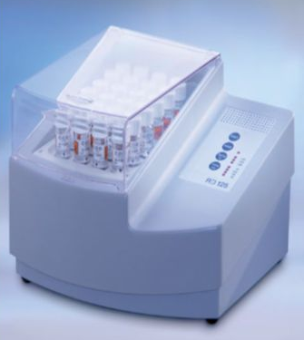
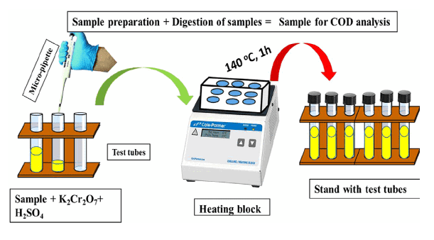
COD Meter

Slide 8
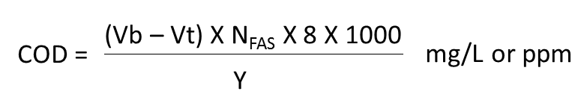
Principle
Vb = Volume of FAS required for blank titration (Zero time)
Vt = Volume of FAS required for reaction mass after time (t)
Y = Volume of waste water sample taken

Slide 9
Significance of COD
COD gives the extent of pollution caused by bio-degradable and non bio-degradable pollutants in wastewater sample
It helps in rapid determination of pollutants level in water compared to BOD
It is taken as a basis for calculation of efficiency and designing of water treatment plants.

Slide 10
Comparison between BOD and COD
BOD | COD
It measures oxygen demand of bio-degradable organic pollutants only | It measures oxygen demand of bio-degradable and non biodegradable organic pollutants
Less stable measurement technique as micro-organisms are susceptible to variables such as pH and temperature | More stable measurement technique as no micro-organisms are used and potassium dichromate oxidizes any type of organic pollutants in water
Slow process, takes 5 days | Fast process , takes 3 hours
BOD values are generally less than COD values | COD values are generally greater than BOD values

Slide 11
Formulae
1. BOD = [(DO)_{Blank} – (DO)_{Incubated} ] x Dilution Factor
(DO)_{Blank} = Dissolved oxygen of diluted sample in the beginning of the reaction
(DO)_{Incubated} = Dissolved oxygen of diluted sample after incubation for 5 days at 20 ⁰ C.
2.
Vb = Volume of FAS required for blank titration (Zero time)
Vt = Volume of FAS required for reaction mass after time (t)
Y = Volume of waste water sample taken

Slide 12
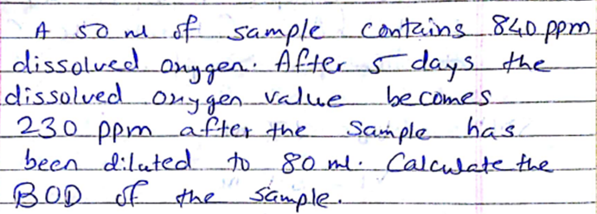

Slide 13
